Slide 1
Introduction to Data Visualization with R using ggplot2
Richard Johansen

Slide 2
Workshop Agenda
Workshop Expectations
Understanding Data
Visualizations
The Scenario
Plotting in ggplot2

Slide 3
Workshop Agenda
Workshop Expectations
Understanding Data
Visualizations
The Scenario
Plotting in ggplot2

Slide 4
Expectations
Assumptions:
You have some basic coding experience or familiarity with a coding environment
You have some general data visualization knowledge (i.e. What is a scatter plot)
Prerequisites:
R and R studio Installed
Install the ggplot2 package
Caveat
This is only a simple introduction to data visualization with ggplot2 and we cannot cover everything but we will cover many of the common aspects you will use most of the time.
Goal
Help you (re)produce print-quality graphics in seconds

Slide 5
Workshop Agenda
Workshop Expectations
Understanding Data
Visualizations
The Scenario
Plotting in ggplot2

Slide 6
What is Data?
Data is a collection of objects defined by attributes
An attribute is a property or characteristic of an object
Examples: eye color of a person, temperature, etc.
Synonyms: variables, fields, characteristics, features, columns, etc.
A collection of attributes describe an object
Synonyms: records, points, cases, samples, instances, rows, etc.

Slide 7
Attribute Values
Each attribute has a set of values objects draw from.
The same attribute can be mapped to different attribute values
Example: height can be measured in meters or feet
Different attributes can be mapped to the same set of values
Example: Attribute values for ID and age are both integers

Slide 8
Attribute Classification
Discrete Attribute – has a infinite or countably infinite set of values
Examples: zip codes, number of words,
Typically represented as integers
Continuous Attribute - has real numbers as attribute values
Example: temperature, height, weight
Typically represented as floating point (decimal)

Slide 9
Important Attribute Classes
Categorical
Nominal - Data that can be counted, but not aggregated or ordered
Examples: Eye Color, Zip Code, Music Genre
Ordinal - Data that can be counted and ordered, but not aggregated.
Examples: Grades, Clothing Size, Positions (in a race)
Numerical
Interval (metrics) - The difference in values are constant and meaningful
Examples: The difference between a temperature of 100°F and 90°F is the same difference as between 90°F and 80°F.
Ratio - An interval scale with an absolute zero
Examples: Income, Height, Weight

Slide 10
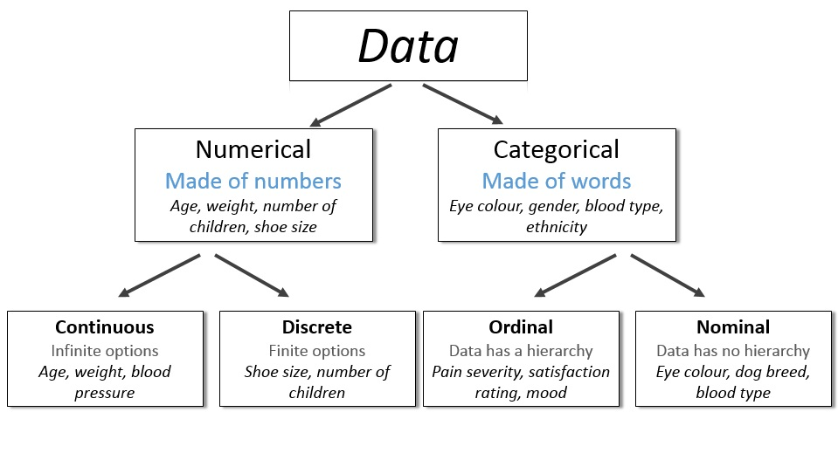
http://survivestatistics.com/variables/

Slide 11
Data Set Classification
Record
Data Matrix
Document Data
Transaction Data
Graph
World Wide Web
Molecular Structures
Ordered
Spatial Data
Temporal Data
Sequential Data

Slide 12
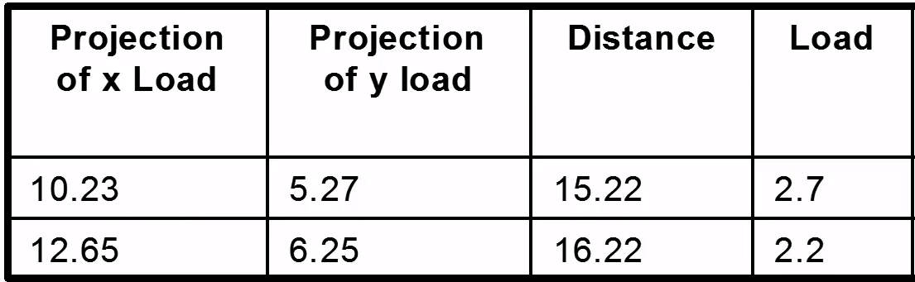
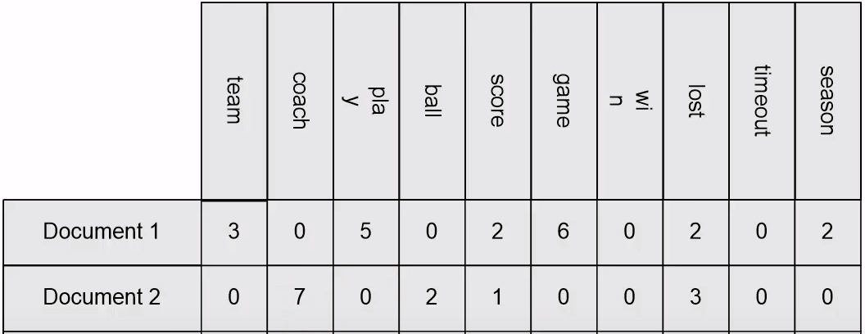
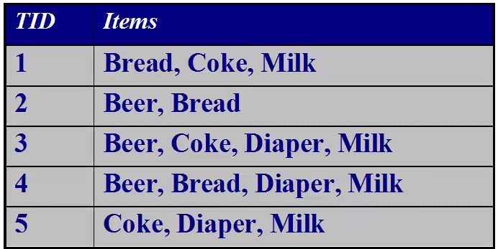
Record Data
Data that consist of a collection of records, each which consists of a fixed set of attributes (Tables)
Data Matrix – Entirely continuous numerical data
Can be plotted in multi-dimensional space (each dimension is an attribute)
Document Data – Each object is a “term” vector (count)
Transaction Data – Each record is a set of items (transactions)

Slide 13
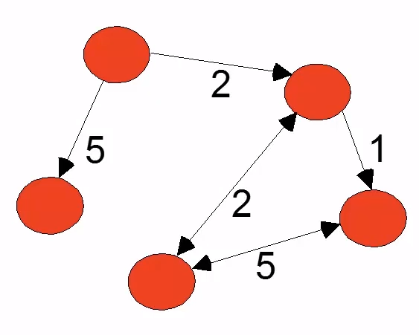
Graph Data
World Wide Web
Nodes, Edges, Direction, Weight
Molecular Structures

Slide 14
Ordered Data
Spatial and Temporal Data
Global Temperature
Sequential Data
Genetic Sequence
GAGAAGGCCTTCCC
https://www.albert.io/learn/ngss-earth-space-sciences/hsess36-anthropogenic-impact-on-systems/analyzing-human-contributions-to-carbon-dioxide-levels-and-ocean-acidification/global-temperature-and-carbon-dioxide-levels?page=1

Slide 15
Data Quality
Main Issues with Data Quality:
Noise and Outliers
Missing Values
Duplicate Data

Slide 16
Primitive Data Types
Boolean:
True (T) or False (F)
Char:
Characters and Strings – “A”, “Beta”, “There are different data types!”
Int:
Integers – (1, 2, 100)
Float/Double:
Decimal – (0.1, 0.2, 0.1352)

Slide 17
Workshop Agenda
Workshop Expectations
Understanding Data
Visualizations
The Scenario
Plotting in ggplot2

Slide 18
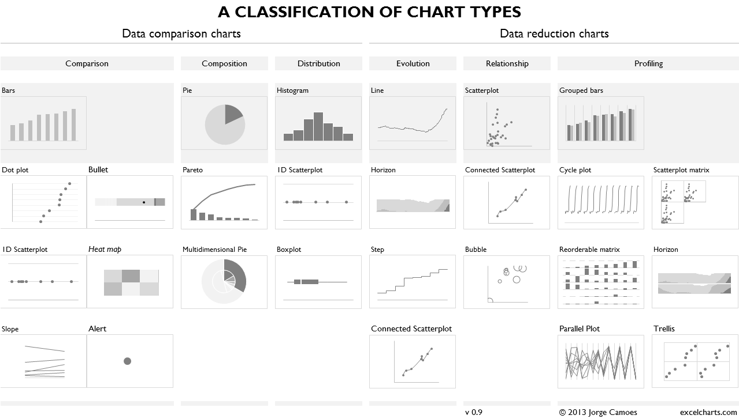
Four Basic Chart Types
Comparison
Composition
Distribution
Relationship
https://excelcharts.com/classification-chart-types/

Slide 19
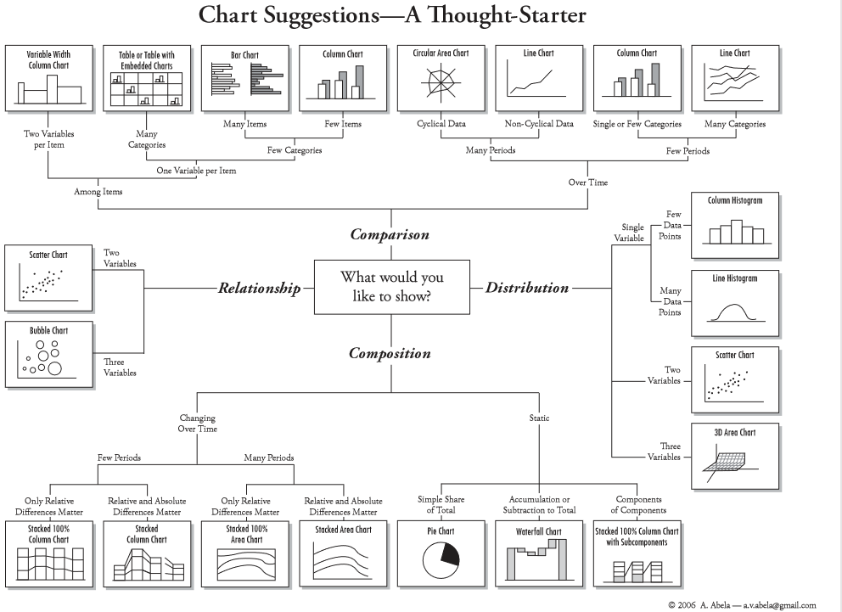

Slide 20
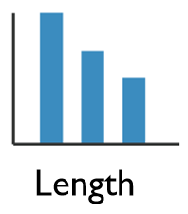
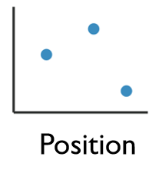
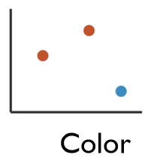
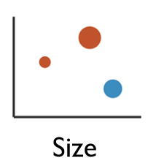
Enhancing Visualizations
1 Dimensional Data
Length
2 Dimensional Data
Position
2+ Dimensional Data
Position
Color Hue/Saturation
Size
Shape

Slide 21
Workshop Agenda
Workshop Expectations
Understanding Data
The Scenario
Visualizations

Slide 22
Titanic Data Set
We will use the Kaggle Competition’s Titanic Machine Learning from Disaster Dataset
Everyone is familiar with the Titanic
The data set is a good representation of real world data
Following the teaching model from Dave Langer’s presentation on Data Science Dojo

Slide 23
Titanic Data Dictionary
Variables:
Survival – Survival (yes=1, no=0)
Pclass – Ticket Class (1st class, 2nd class)
Sex – Gender (Male or Female)
Age – Passenger age
Sibsp – # of Siblings/Spouse
Parch – # of Parents/Children
Ticket – Ticket Number
Fare – Passenger Fare
Cabin – Cabin Number
Embarked – Port of Embarkation

Slide 24
Your Job
You are hired as a consultant and have been tasked with analyzing the titanic data set.
Your goal is to explore patterns and trends to explain what influenced the survival rate of the passengers on the Titanic.

Slide 25
Grammar of Graphics
Originated by Leland Wilkinson, simplified by Hadley Wickham and others.
Data – The raw materials of your visualization
Layers – What you actually see on the plot (plots,lines,etc.)
Scales – Maps the data to grpahical output
Coordinates – The visualization’s perspective (normally a grid)
Faceting – Provides details into the data (analoguous to pivot tables)
Themes – Control the details of the display (color scheme, fonts)
http://vita.had.co.nz/papers/layered-grammar.pdf
Notes:
Alison

Slide 26
The Basics
Data – The raw materials of your visualization
Aesthetics – The mapping of your data to the visualization
X-axis is age
Y-axis is survival
Layers – Any visualization requires at least one layer and in ggplot2 these are typically the geoms.
Example a barchart is geom_bar()

Slide 27
Questions?

